Slide 1




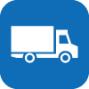

The NDRRMC-Logistics Web Application is divided into three (3)
modules, namely
Procurement
User Management
Transport
Logistics Cluster

Slide 2
User Management
User Management
Now, on to the User Management Module
Under this module lies the handling of the different users this system
caters to.
Logistics Cluster

Slide 3
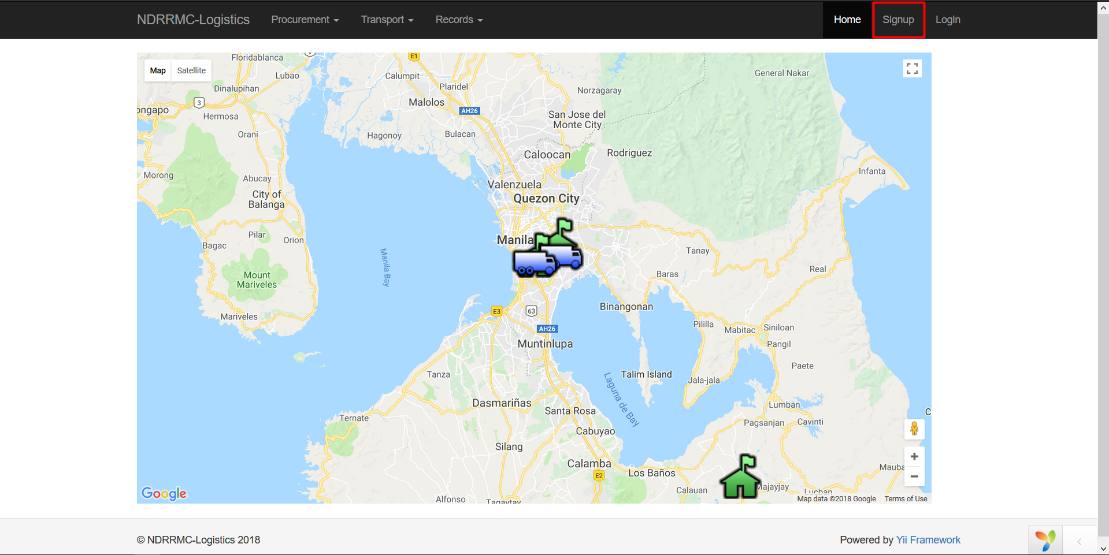
User Management
Logistics Cluster
To register a user, go to the home page and click on the signup button

Slide 4
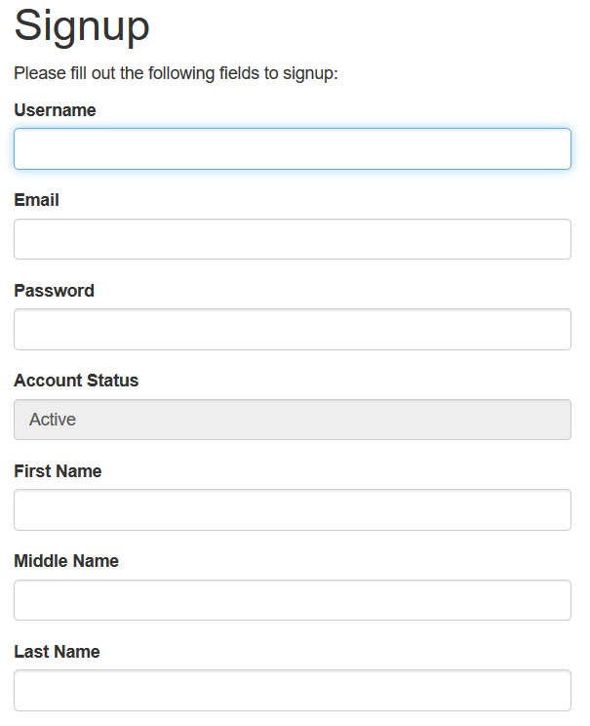
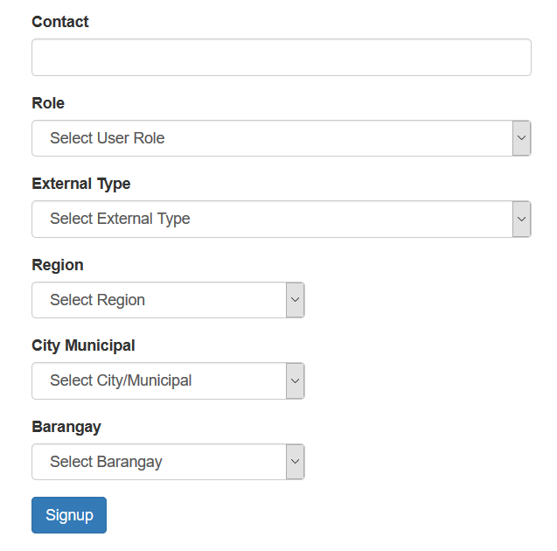
User Management
Logistics Cluster
These are the following fields to be filler up in making a user.

Slide 5
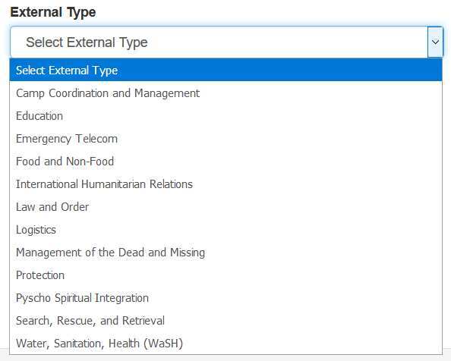
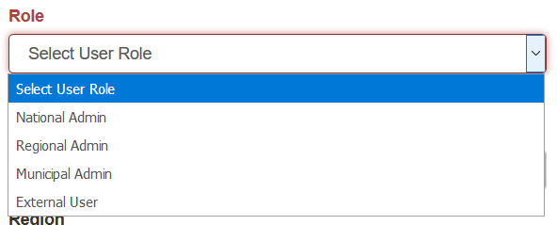
User Management
The system caters to four (4) different users, the National Admin,
Regional Admin, City/Municipal Admin, and External Users.
Logistics Cluster
External Users are then divided into the 12 cluster groups.

Slide 6
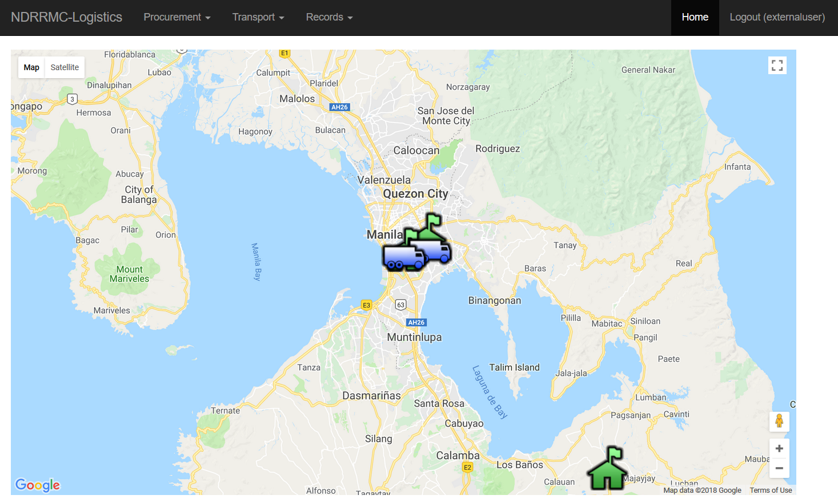
After successfully signing in, your screen will be redirected to the
homepage so you can access the different modules.
User Management
Logistics Cluster
Procurement

Slide 7




User Management
Procurement
Now, on to the Procurement Module
Procurement is the process of gathering resources. This system will
cater the following operations.
Create
View
Update
Delete
Logistics Cluster
of Suppliers, Resources, and Requests.

Slide 8
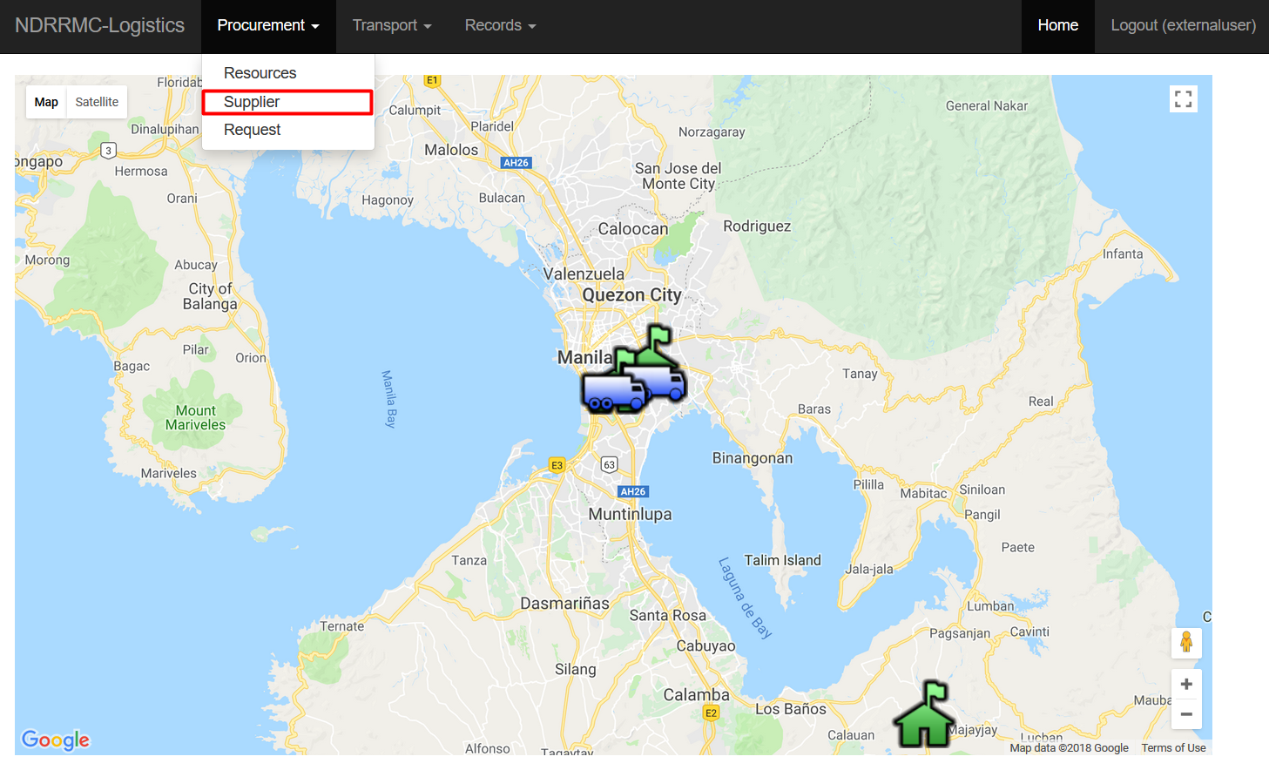
For Creating Suppliers, go to the Procurement Tab, and choose Supplier
Procurement
Logistics Cluster

Slide 9
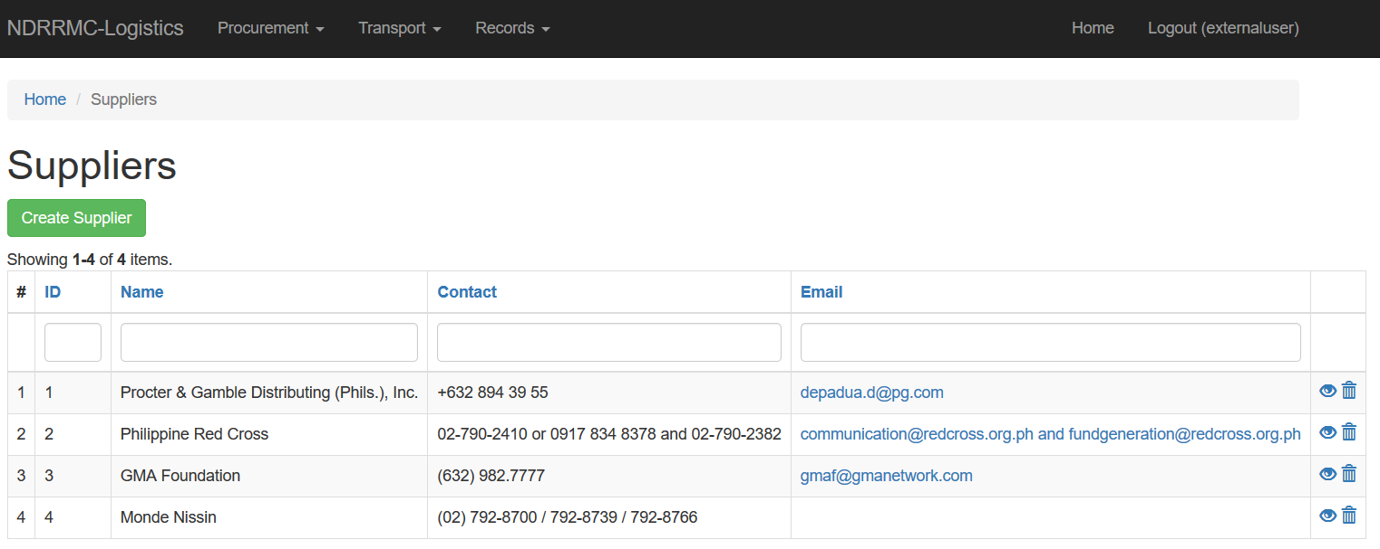
This will re-direct you to the Supplier home page
Procurement
This will display all the recorded suppliers. The user has the option
Logistics Cluster
to CREATE, VIEW, UPDATE, and DELETE suppliers.

Slide 10
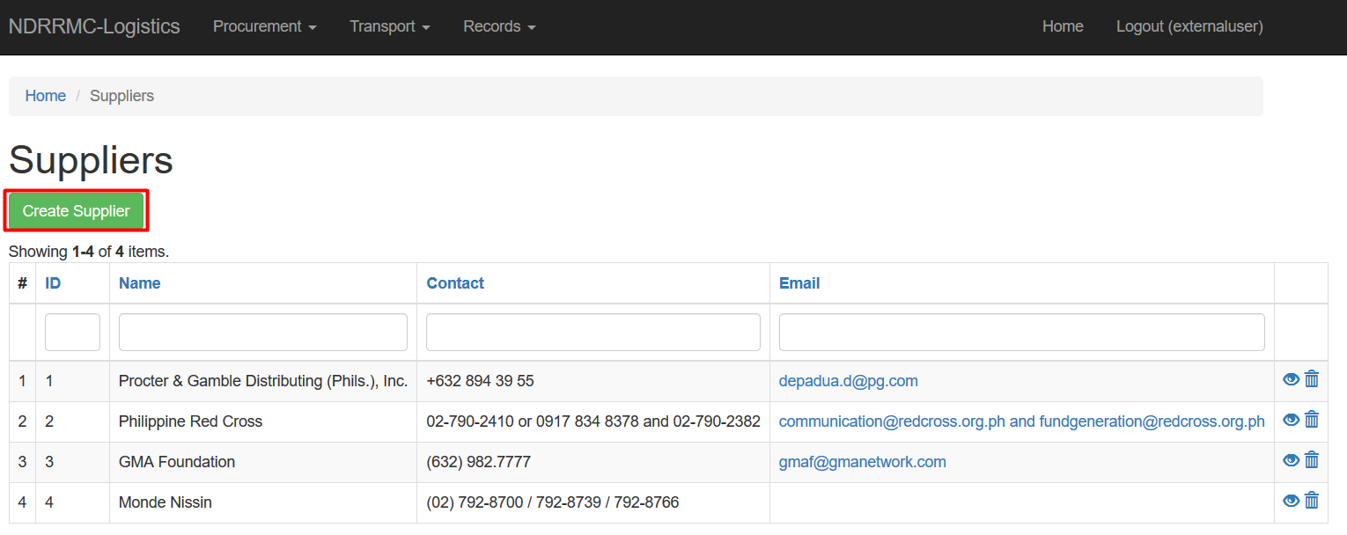
For creating suppliers, click the “Create Supplier” button.
Procurement
This will re-direct you to the web page to fill-in the required fields
Logistics Cluster
for creating a supplier.

Slide 11
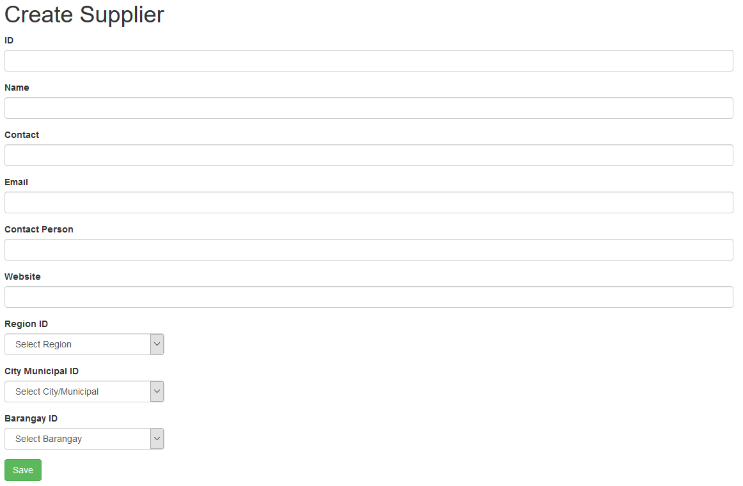
These are the fields the user has to fill-in to create a supplier.
Procurement
Logistics Cluster

Slide 12
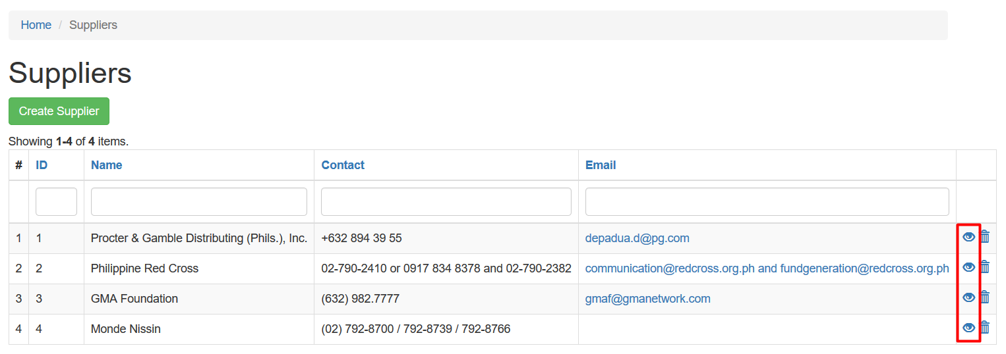
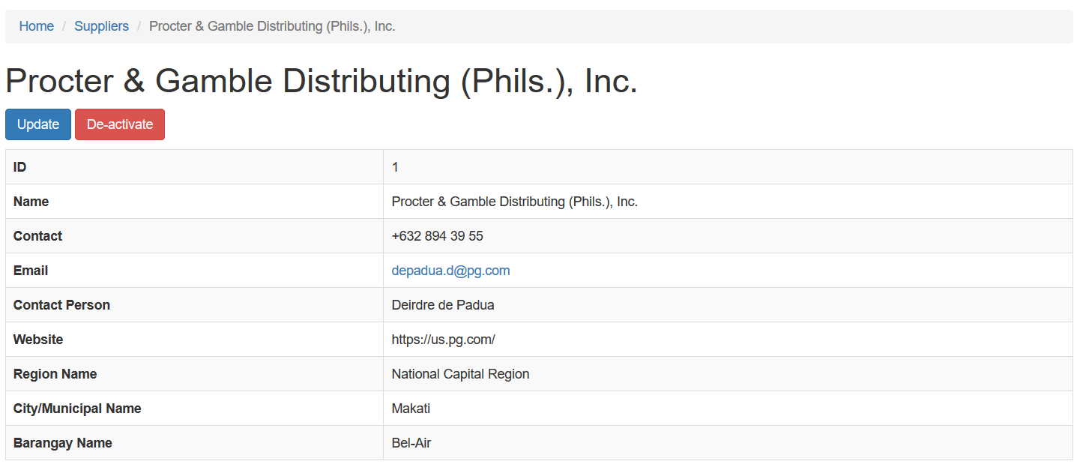
To view the suppliers, click the EYE icon on the rightmost column
Procurement
It will then show a much more detailed view of the selected supplier
Logistics Cluster

Slide 13
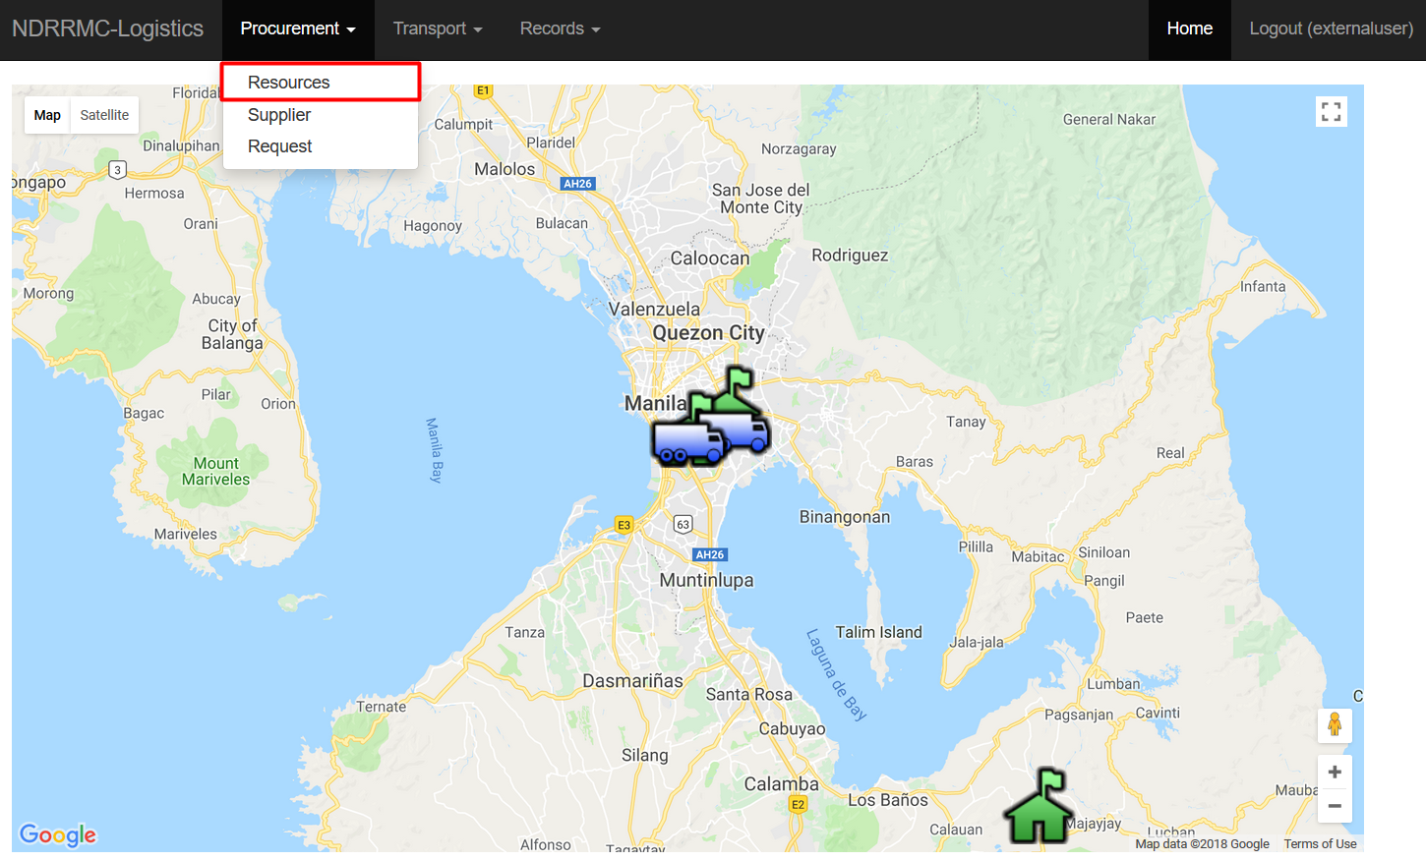
For Creating Resources, go to the Procurement Tab, and choose Resources
Procurement
Logistics Cluster

Slide 14
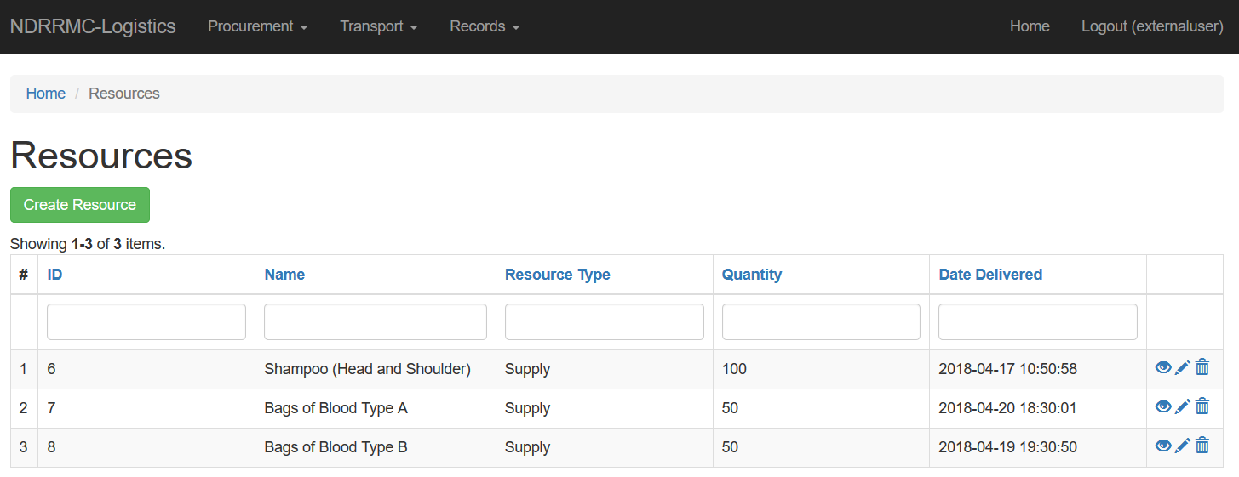
This will re-direct you to the Resources home page
Procurement
This will display all the recorded resources. The user has the option
Logistics Cluster
to CREATE, VIEW, UPDATE, and DELETE suppliers.

Slide 15
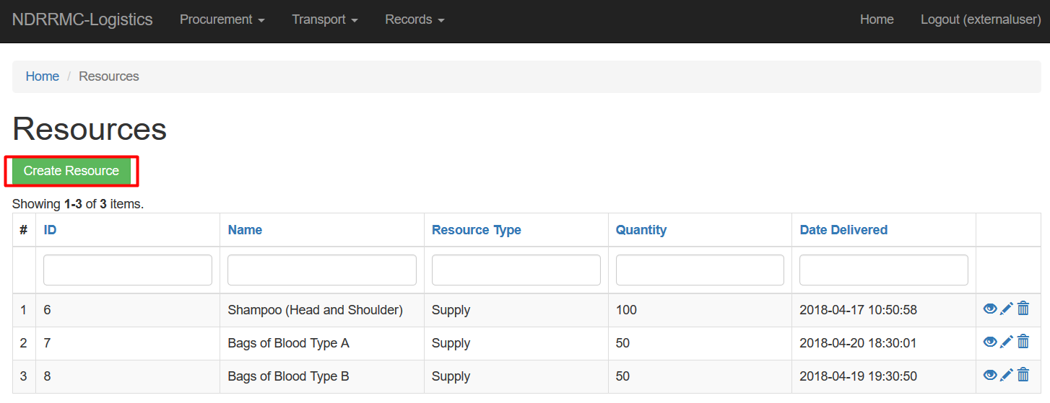
For creating resources, click the “Create Resources” button.
Procurement
This will re-direct you to the web page to fill-in the required fields
Logistics Cluster
for creating a resource.

Slide 16
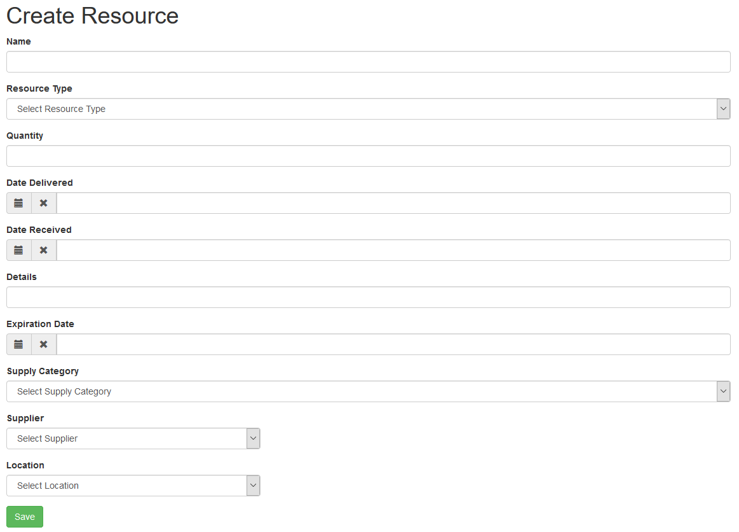
These are the fields the user has to fill-in to create a Resource.
Procurement
Logistics Cluster

Slide 17
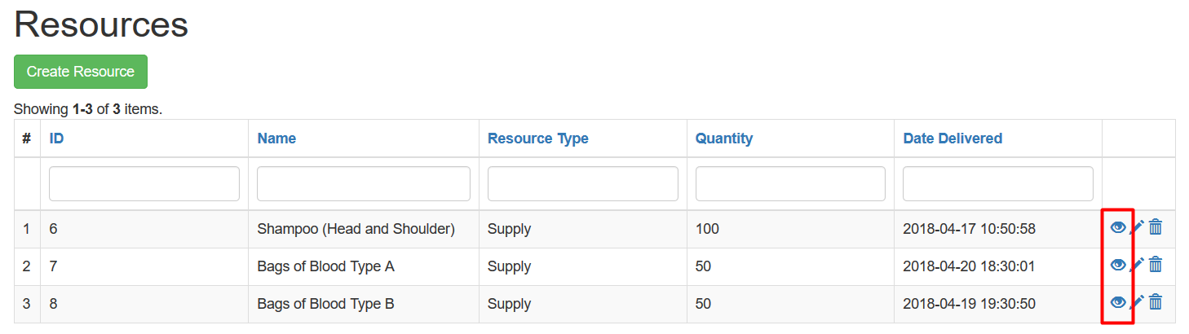
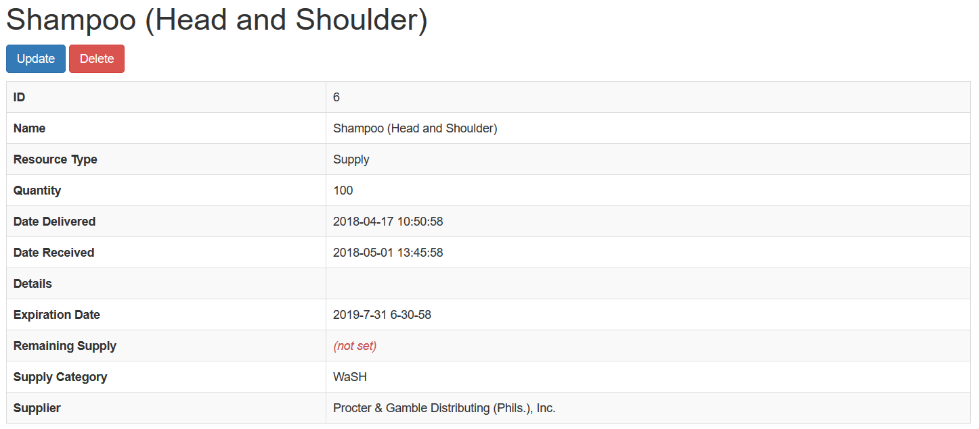
To view the resources, click the EYE icon on the rightmost column
Procurement
It will then show a much more detailed view of the selected resource
Logistics Cluster

Slide 18
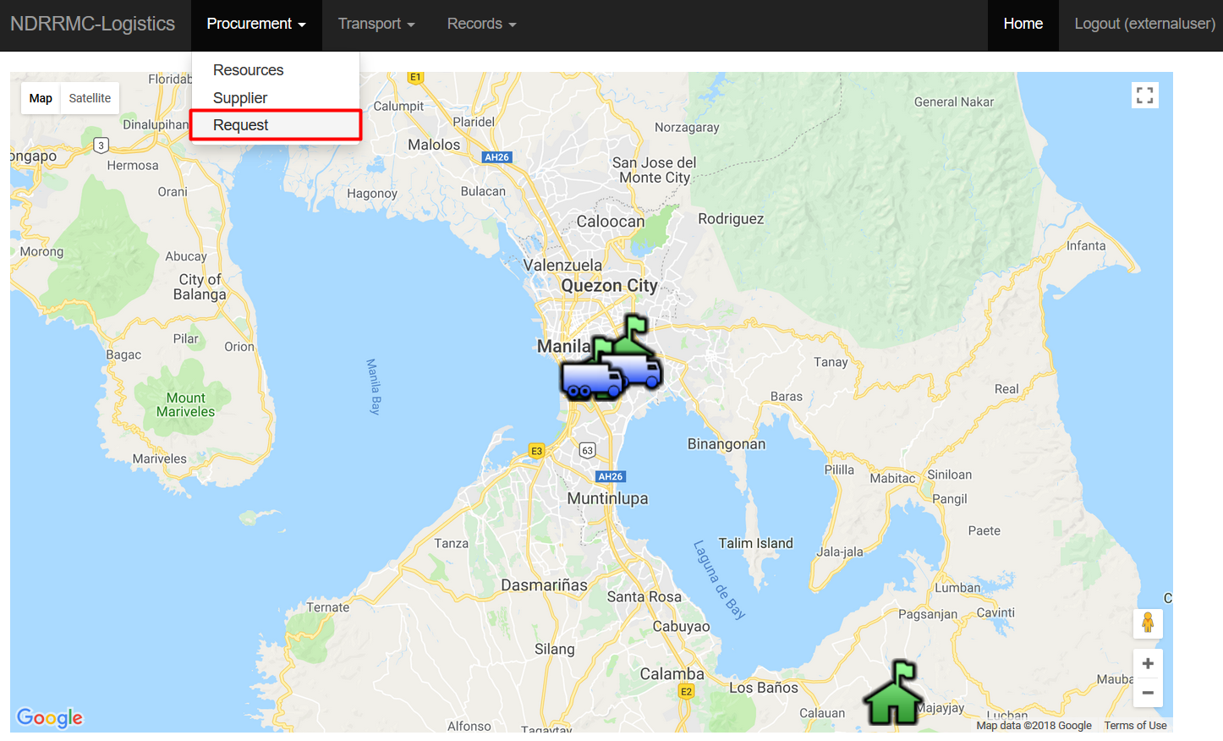
For creating Requests, go to the Procurement Tab, and choose Request
Procurement
Logistics Cluster

Slide 19
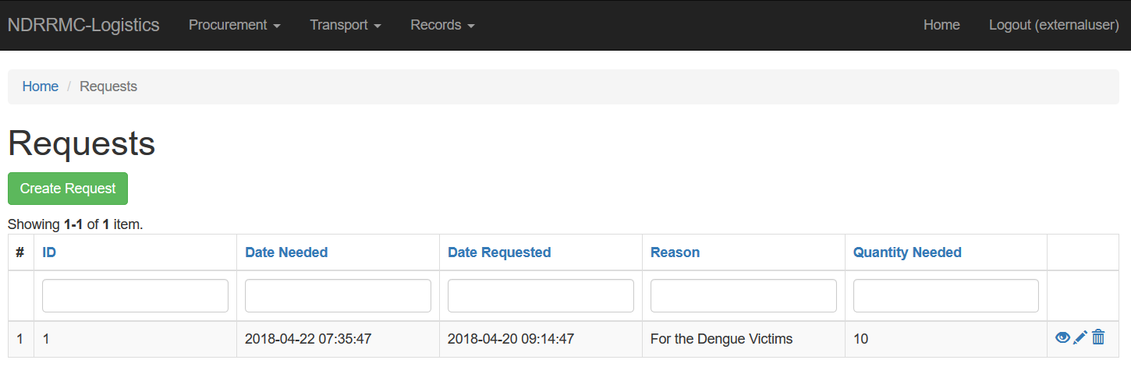
This will re-direct you to the Requests home page
Procurement
This will display all the recorded requests. The user has the option
Logistics Cluster
to CREATE, VIEW, UPDATE, and DELETE requests.

Slide 20
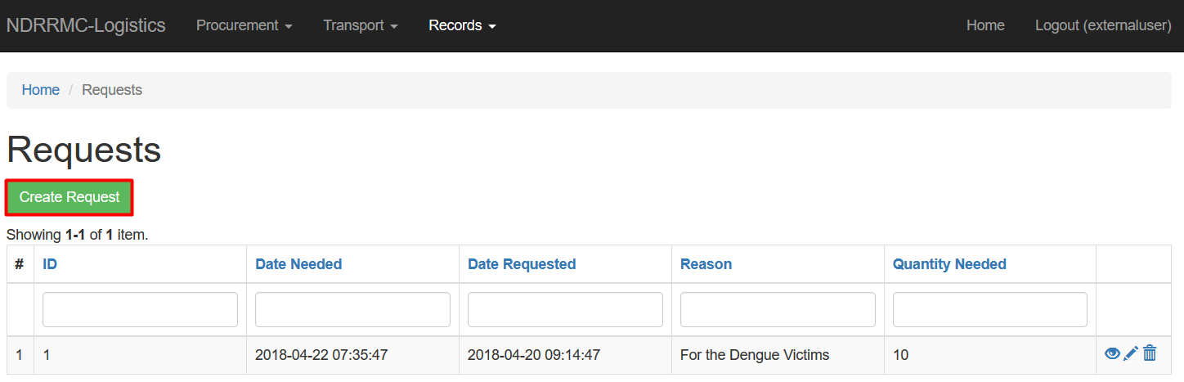
For creating requests, click the “Create Request” button.
Procurement
This will re-direct you to the web page to fill-in the required fields
Logistics Cluster
for creating a request.

Slide 21
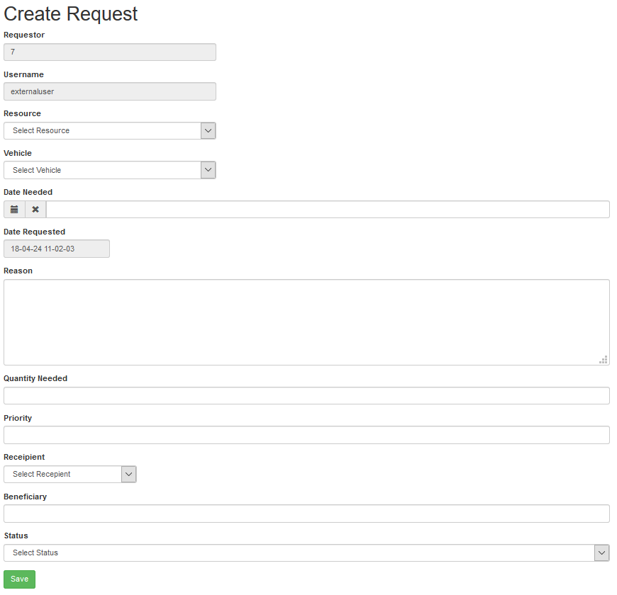
These are the fields the user has to fill-in to create a Request.
Procurement
Logistics Cluster

Slide 22
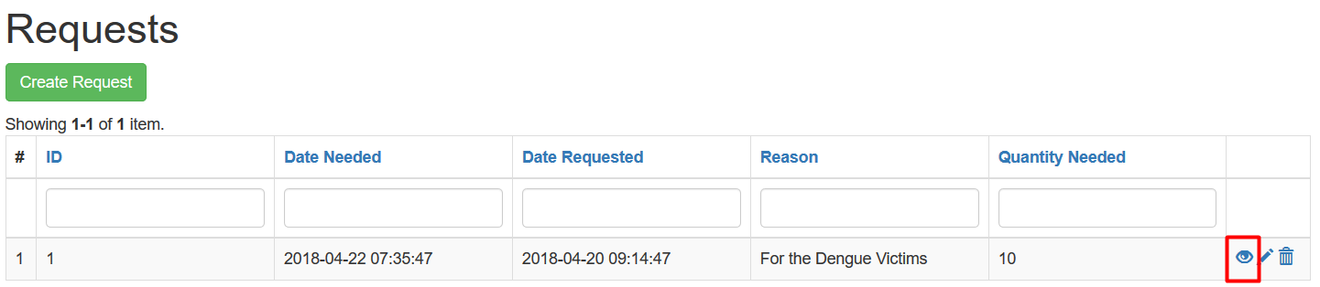
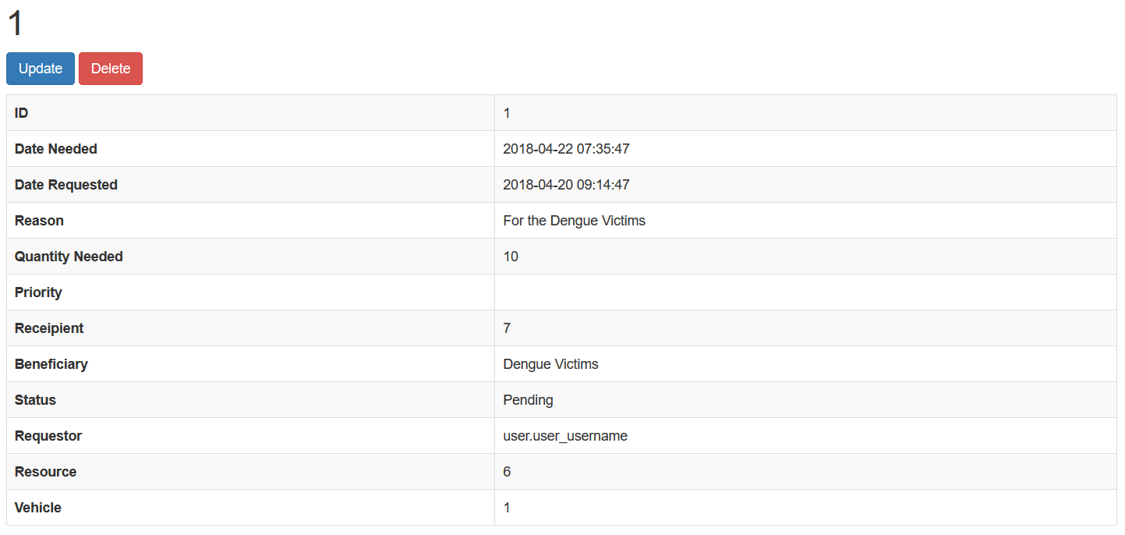
To view the requests, click the EYE icon on the rightmost column
Procurement
It will then show a much more detailed view of the selected request
Logistics Cluster

Slide 23
User Management
Transport
Now, on to the Transport Module
Under this module lies the handing of locations and vehicles that are
modified using the following operations:
Create
View
Update
Delete
Logistics Cluster

Slide 24
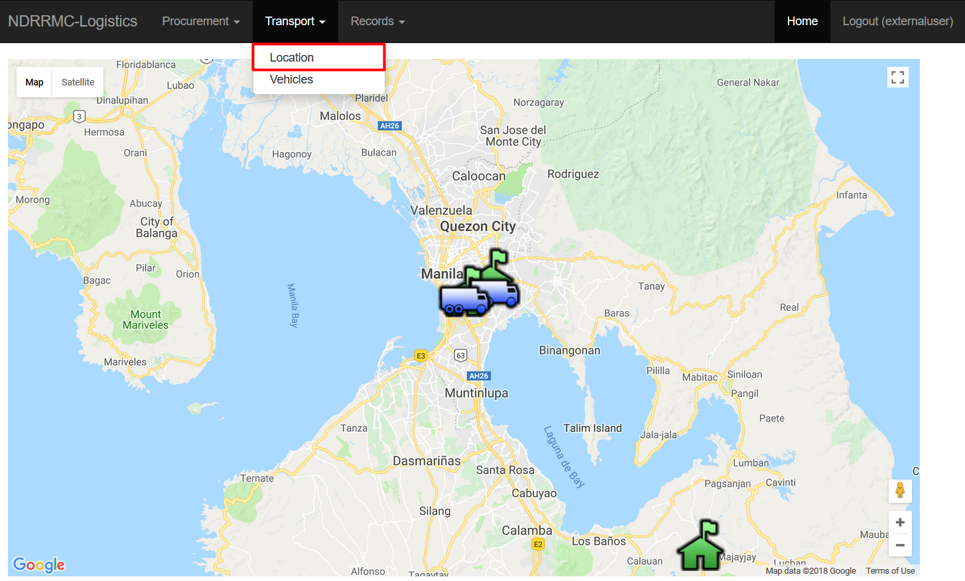
For creating Locations, go to the Transport Tab, and choose Location
Transport
Logistics Cluster

Slide 25
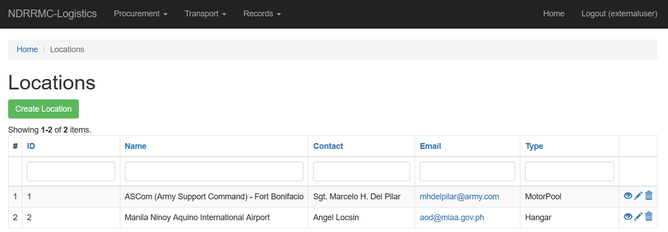
This will re-direct you to the Locations home page
Transport
This will display all the recorded locations. The user has the option
Logistics Cluster
to CREATE, VIEW, UPDATE, and DELETE locations.

Slide 26
For creating requests, click the “Create Location” button.
Transport
This will re-direct you to the web page to fill-in the required fields
Logistics Cluster
for creating a location.

Slide 27
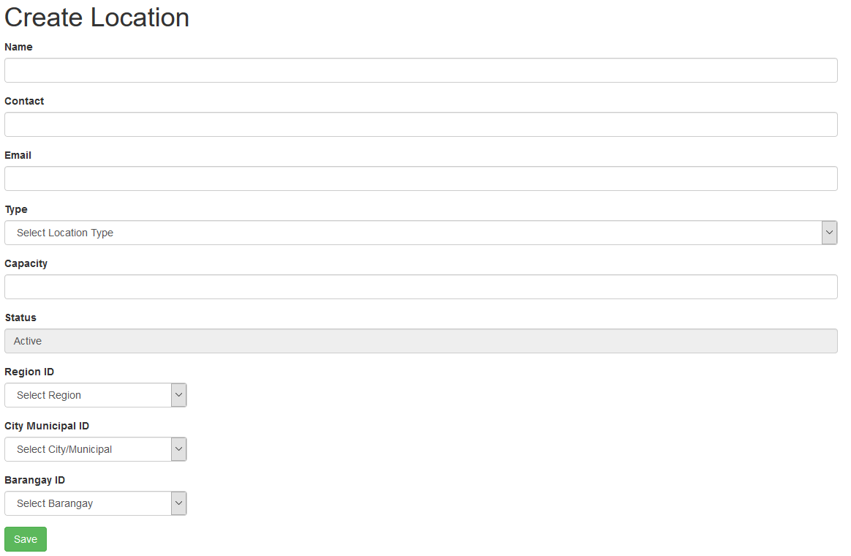
These are the fields the user has to fill-in to create a Request.
Transport
Logistics Cluster

Slide 28
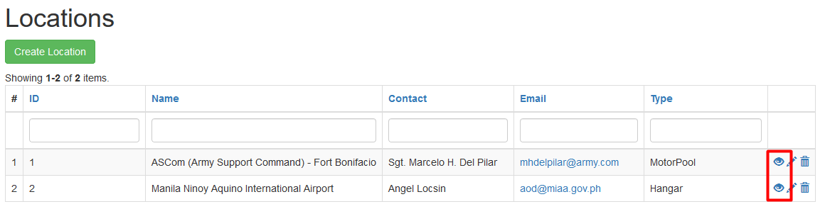
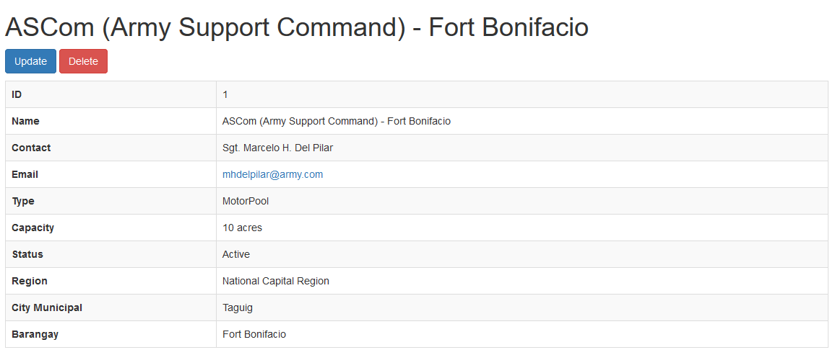
To view the locations, click the EYE icon on the rightmost column
Transport
It will then show a much more detailed view of the selected location
Logistics Cluster

Slide 29
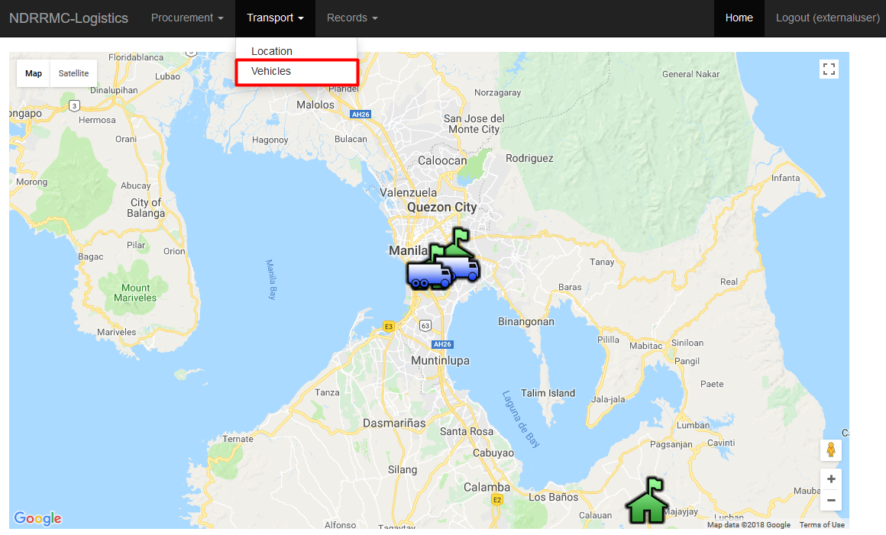
For creating Vehicles, go to the Transport Tab, and choose Vehicles
Transport
Logistics Cluster

Slide 30
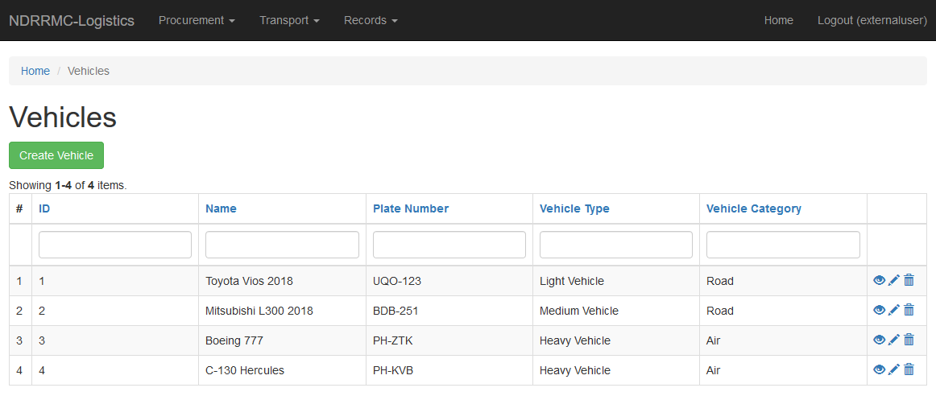
This will re-direct you to the Vehicles home page
Transport
This will display all the recorded vehicles. The user has the option
Logistics Cluster
to CREATE, VIEW, UPDATE, and DELETE vehicles.

Slide 31
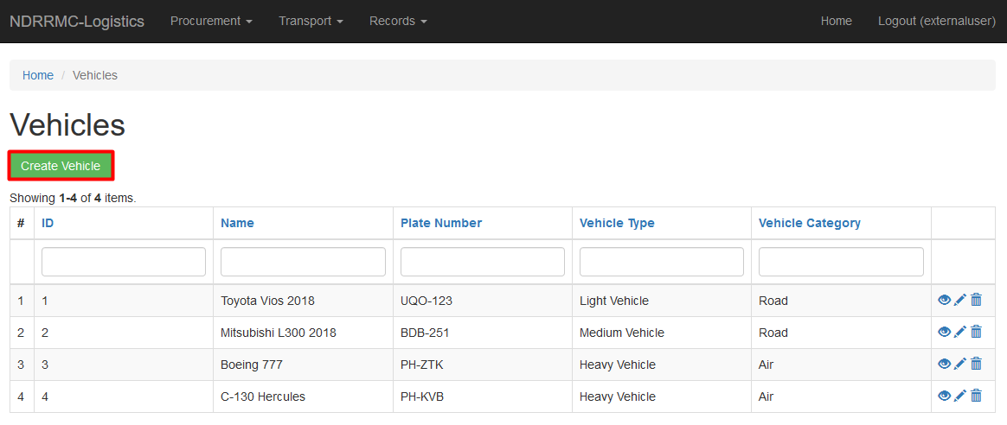
For creating requests, click the “Create Vehicles” button.
Transport
This will re-direct you to the web page to fill-in the required fields
Logistics Cluster
for creating a vehicle.

Slide 32
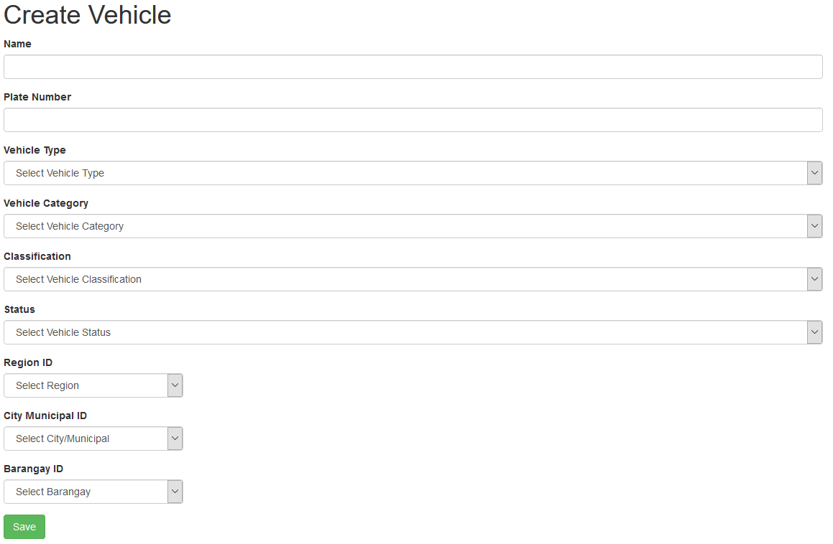
These are the fields the user has to fill-in to create a Vehicle.
Transport
Logistics Cluster

Slide 33
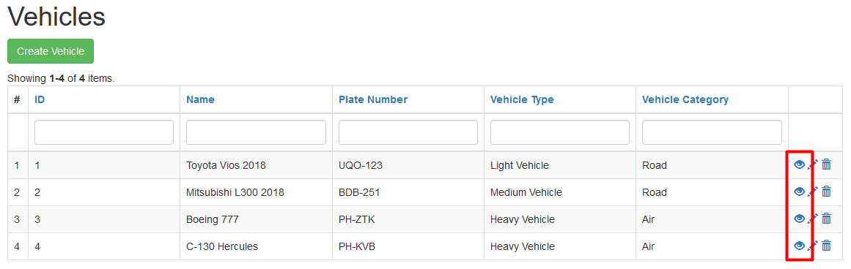
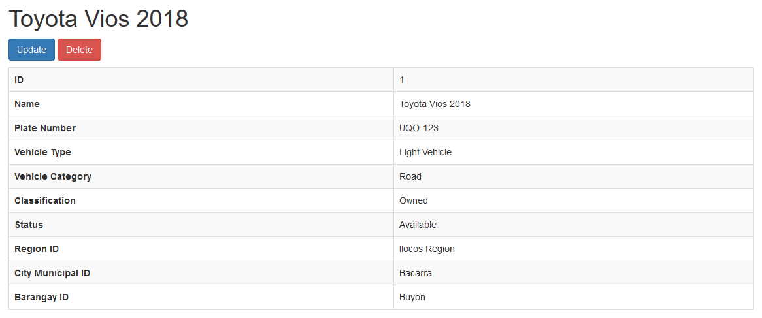
To view the vehicles, click the EYE icon on the rightmost column
Transport
It will then show a much more detailed view of the selected location
Logistics Cluster

